Slide 1
Employee Data Analysis using Excel
STUDENT NAME: MONIKA.M
REGISTER NO: 122203892
NAM ID :72DFA7462A2FCE2A623421AFB9E8845C
DEPARTMENT: B. Com Corporate Secretaryship
COLLEGE: Shri Shankarlal Sundarbai Shasun Jain College for Women

Slide 2
PROJECT TITLE
Employee Performance Analysis using Excel

Slide 3


AGENDA
Problem Statement
Project Overview
End Users
Our Solution and Proposition
Dataset Description
Modelling Approach
Results and Discussion
Conclusion
3/21/2024 Annual Review

Slide 4

PROBLEM STATEMENT
The reason we are doing the employee performance in an organisation for his increment and track his performance so that we can able to focus on the growth. Definitely the growth is based on the employee’s performance and their personal growth. For good performer workers they will give bonus, increment. For low performer workers they will motivate them to do in better/effective manner. For all these we should do the employee data analysis.

Slide 5

PROJECT OVERVIEW
Employee data analysis:
Analysing the performance of the employee. By considering various aspects like gender, performance score, rating and by their achievements. Based on doing these analysis is called Employee performance analysis. In order to identify the trends and patterns of different categories of employee’s like High, Medium and Low.

Slide 6
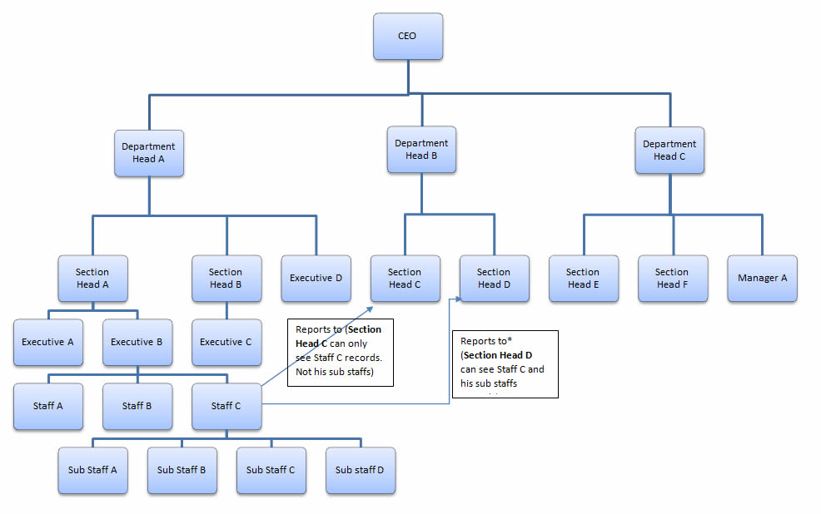

WHO ARE THE END USERS?

Slide 7

OUR SOLUTION AND ITS VALUE PROPOSITION
Conditional Formatting – Missing
Filter – Remove
Formula – Performance
Pivot – Summary
Graph – Data Visualization

Slide 8
Dataset Description
Employee = Edrunet Foundation
26 – Features
9 – Features
Emp id – num
Name – text
Emp type
Performance level
Gender – male female
Employee rating - num

Slide 9

THE "WOW" IN OUR SOLUTION
Performance level =IFS(Z8>=5,"VERY HIGH",Z8>=4,"HIGH",Z8>=3,"MED","TRUE","LOW")
3/21/2024 Annual Review
9

Slide 10
MODELLING
Data collection
From Edrunet foundation
Data cleaning
Missing value identification
Missing value filter out
Performance level
Through current employee rating
Summary
Pivot table
Rows
Columns
Filters
Slicer
Graph
10

Slide 11
RESULTS
11

Slide 12
conclusion
I conclude that compare to other level of employees the med level employees are more. And for the other type of employees we can motivate them to perform well.

